Slide 1

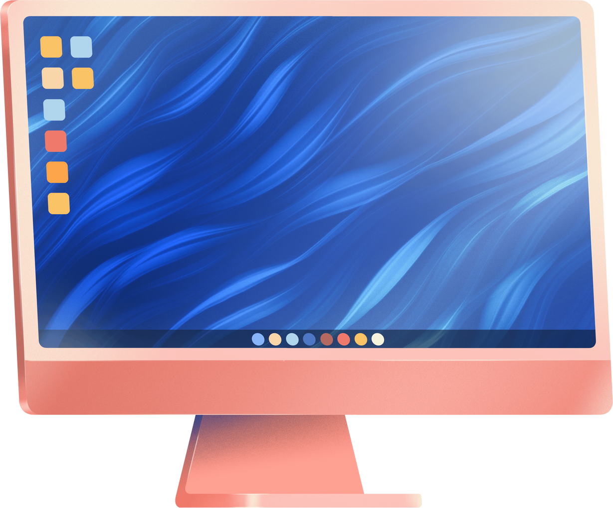


Foundation
Table
Page 01

Slide 2
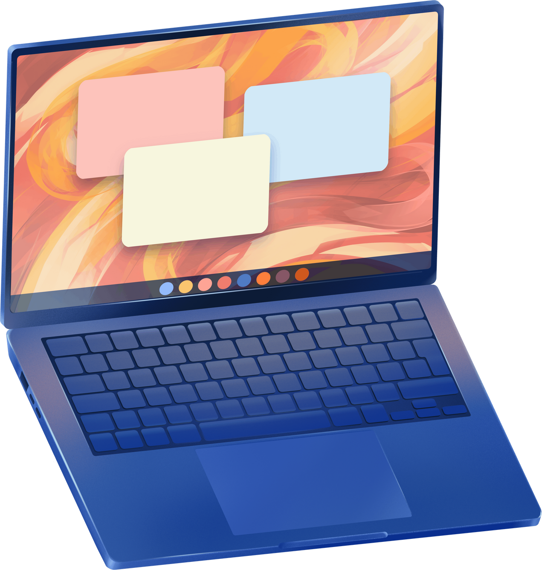
Introduction to Foundation Framework
What is Foundation ?
=>Foundation is a front-end framework Created by ZURB for building responsive , mobile-first Website
Purpose
=>Helps developers build accessible , adaptable and professional
Website quickly
Page 02

Slide 3

Key Features of Foundation
Responsive Grid System
=>Flexible, grid-based layout for building dynamic designs
Built-in Component
=>Includes Component like navigation, form, button and
models
Sass Integration
=> Allows for customization and modular design through
Scss
Page 03

Slide 4
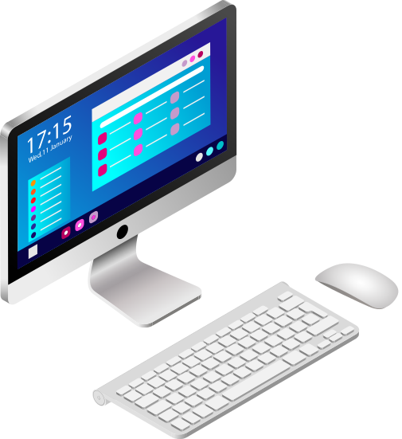
Popular Use Cases
E-Commerce Sites
=>Dynamic layout and responsive product grid
Corporate Website
=>Professional, Adaptable templates for branding
Web Apps
=>Foundation is well-Suited for applications requiring user
interaction
Page 04

Slide 5
Add the Foundation CSS Link
<head>
<title>My Foundation Page</title>
<link rel="stylesheet" href="https://cdn.jsdelivr.net/npm/foundation-sites@6.7.5/dist/css/foundation.min.css">
</head>
Page 05

Slide 6
Add Foundation JavaScript
<body>
<!-- Your HTML content here -->
<script src="https://cdn.jsdelivr.net/npm/jquery@3.6.0/dist/jquery.min.js"></script>
<script src="https://cdn.jsdelivr.net/npm/foundation-sites@6.7.5/dist/js/foundation.min.js"></script>
<script>
$(document).foundation();
</script>
</body>
Page 06

Slide 7
Foundation Table
<div class="grid-container">
<h1 class="text-center">Foundation Styled Table</h1>
<table class="table">
<thead>
<tr>
<th>Column 1</th>
<th>Column 2</th>
<th>Column 3</th>
<th>Column 4</th>
</tr>
</thead>
<tbody>
<tr>
<td>Data 1</td>
<td>Data 2</td>
<td>Data 3</td>
<td>Data 4</td>
</tr>
</tbody>
</table>
</div>
Page 07

Slide 8


Thank
You.
debjitpatra8521gmail.com
8521445687
Page 8

